Slide 1
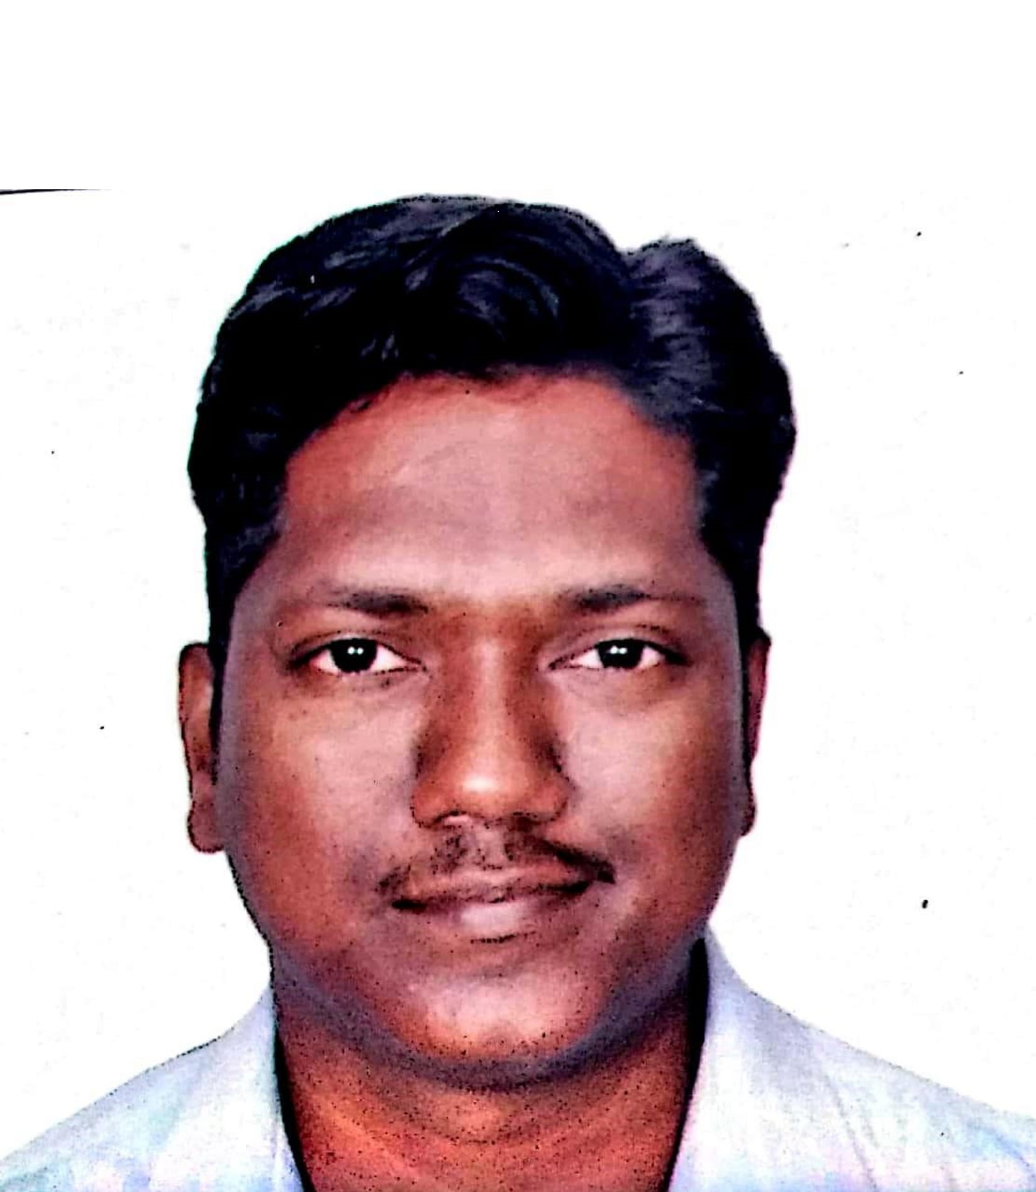
Profile: Ganesh Vedapuri – Lead/Technical Architect
Summary
IT Industry experience of 13 years 9 months Key Domains: Supply Chain, Banking, Insurance, Healthcare, Manufacturing, Automobile,.
Area of Expertise
Conceptualizing and delivering technology solution and architecture for building blocks of Digital Transformation Experience in development of web-based applications using ASP.NET MVC framework. Experience in designing and developing, deploying Windows Services, Web Services, WCF services and ASP.NET Web API. Experience in development of web-based applications using ASP.NET Core. Experience in Responsive web-based page and site designs using JavaScript, AJAX, LINQ, HTML, jQuery, CSS technologies and Angular. Designing and Delivering cloud platform and integration as a service solution such as Logic Apps ,Azure Functions ,Event Hub, Event Grid , Service Fabric and Service Bus Queue Implementing Azure API Management to act as a gateway for backend API’s and Microservices Azure AD Authentication using Oauth OIDC ,SAML, WS Trust and WS Federations and Security implementation using Azure Key Vault, App configurations Experience in Microservices & Container based development using Docker, Azure Kubernetes Service(AKS) Designing and implementing monitoring solution using Azure monitor, log analytics workspace and application insights.
Education
Bachelor of Engineering in Computer Science from Anna University , India.
Azure Cloud Experience
Lead/Architect – HCL Coles Paperless(3 years) Building Integration Solutions for multiple applications of Manufacturing Module on Azure & leading implementation efforts on cloud migration methodology and frameworks, application modernization projects.
Other Experience Summary
Asist develop and drive a technical roadmap which incorporates technology and systems that build towards the strategic direction of the organization. Identify and manage “proof of concepts” for emerging technologies solutions to improve business KPI’s. Worked on various large & complex IT programs, Onshore-Offshore delivery models, agile methodologies, Presales & RFP teams and IT consulting Designing and Developing .NET , Angular ,Business intelligence (SSIS, SSRS) applications Led the solution design and development of Azure platform build up and application migration Hands on experience on Microsoft .NET Technology stack and Azure solutions. Worked as solution and integration architect for external systems. Implementation of storage solutions like Azure Blob Storages, Table, Queue, Azure SQL , Cosmos DB, Virtual Machines. Implementation of CICD model using Azure DevOps Experience in JIRA , Confluence for following Agile Processes. Azure Cloud Certifications AZ 204 : Microsoft certified Azure Developer Associate AZ 900 : Microsoft certified Azure fundamentals

